Slide 1

Programming Jobs Application Prediction

Slide 2
Name : Pritkumar Yadav Class : T.Y. B.Sc Data Science Roll No : 10 Project Title : Programming Job Application Prediction

Slide 3
Index
Introduction
Aim
Project Overview
Data Preprocessing
Segment Countries
Exploratory Data Analysis
Correlation Heatmap
Machine Learning Model Selection
Decision Tree Algorithm
ROC Curve
Random Forest Classifier
XGBoost Classifier
Conclusion
Reference

Slide 4
Introduction
In the modern job market, technology and programming skills have become increasingly valuable assets. As a result, many individuals aspire to enter the field of programming and software development.
Programming job application prediction is the process of using data analysis and machine learning techniques to assess the likelihood of a job applicant successfully securing a programming position.
It involves the evaluation of various factors and variables to estimate the probability of a candidate's application being accepted.

Slide 5
Aim
The primary aim of the Programming Job Application Prediction system is to leverage data analysis and machine learning techniques to enhance the efficiency and effectiveness of the programming job application process for both job applicants and employers.
Specifically, the system aims to:
Improve Applicant Success Rates
Enhance Hiring Efficiency
Reduce Bias and Subjectivity
Optimize Resource Allocation
Promote Data-Driven Recruitment

Slide 6

Project Overview
This project, "Programming Job Application Prediction," utilizes Jupyter Notebook as its primary tool to develop and deploy predictive models.
It aims to improve the efficiency and fairness of the programming job application process by leveraging data analysis and machine learning to predict the success of job applications, providing valuable insights for both job applicants and employers in the programming industry.

Slide 7
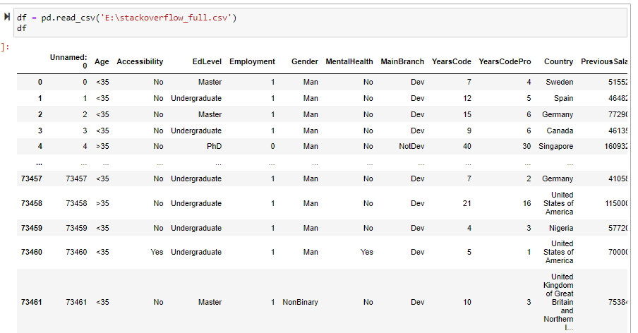
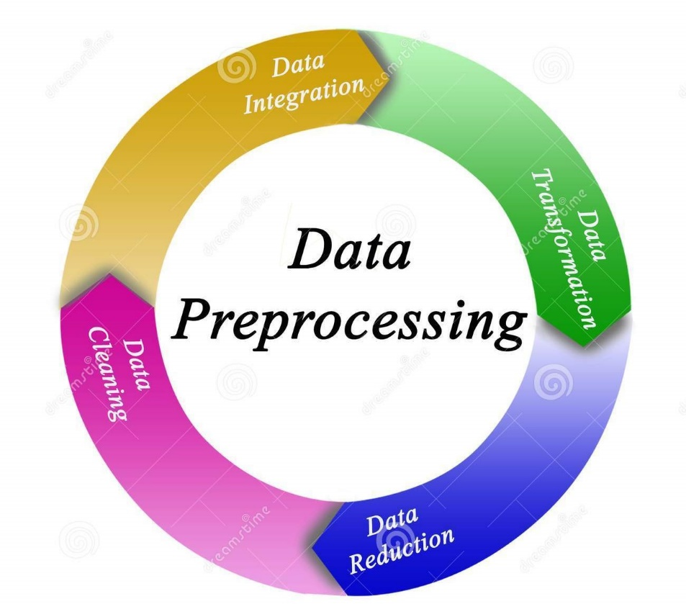
Data Preprocessing
Data preprocessing plays a crucial role in ensuring the accuracy and reliability of predictive models within Jupyter Notebook.
Data Collection
Data Loading
Handling Missing Values
Data Cleaning
Feature Encoding
Data Splitting
Efficient data preprocessing in Jupyter Notebook is essential to prepare the dataset for model training, improving the quality of predictions in the "Programming Job Application Prediction" project. It ensures that the data is clean, well-structured, and suitable for machine learning algorithms, ultimately contributing to the accuracy and reliability of the predictive models.

Slide 8
Segment Countries
Europe
Oceania
South America
North America
Asia
Others
Segmenting countries can be a valuable step to analyze and predict job application success on a regional or global scale. This can be achieved using a function defined within Jupyter Notebook.
Create a Python function within Jupyter Notebook to segment countries based on various criteria, such as economic factors, job market demand, or cultural differences.
Segmenting countries provides insights into the varying dynamics of job applications, enabling applicants and employers to adapt to regional differences and increase the chances of a successful match in the "Programming Job Application Prediction" project.

Slide 9

Exploratory Data Analysis
EDA using Jupyter Notebook is a crucial initial step. EDA allows for a comprehensive understanding of the dataset, which is essential for building accurate predictive models.
Data Visualization
Statistical Summary
Correlation Analysis
Effective EDA within Jupyter Notebook lays the foundation for the development of accurate predictive models, ensuring that data is understood and preprocessed appropriately to enhance the project's success in predicting programming job application outcomes.

Slide 10
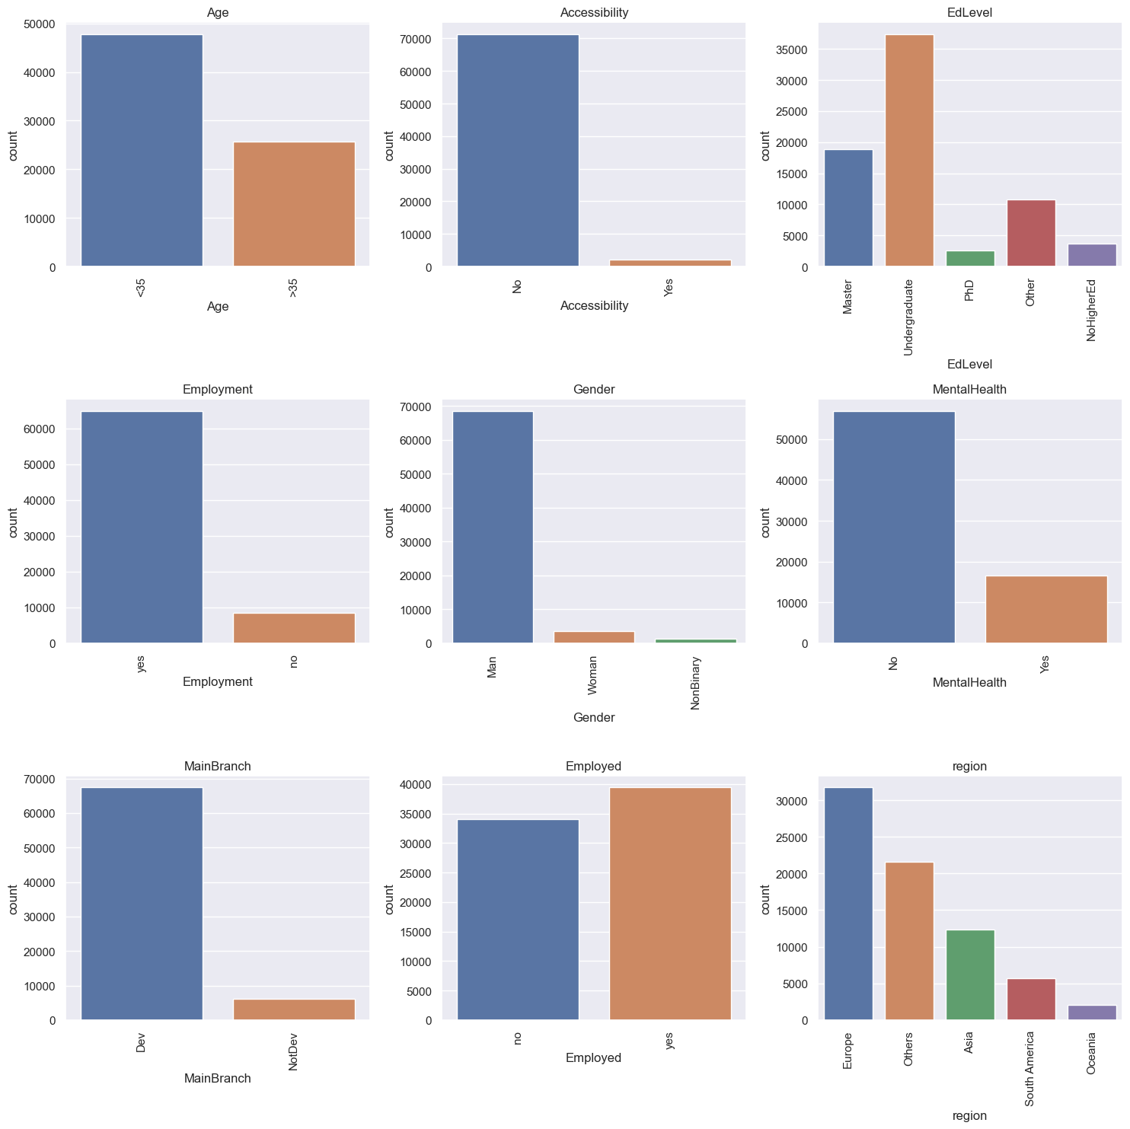

Slide 11
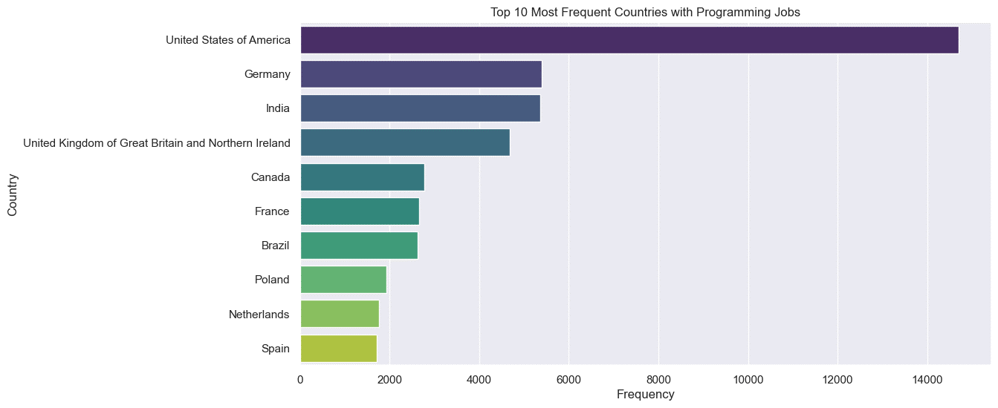


Slide 12

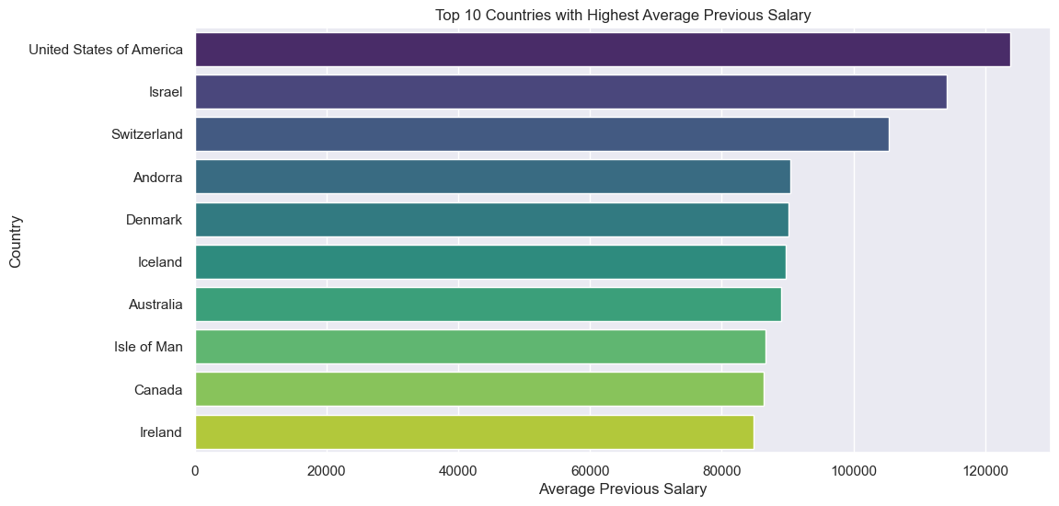

Slide 13
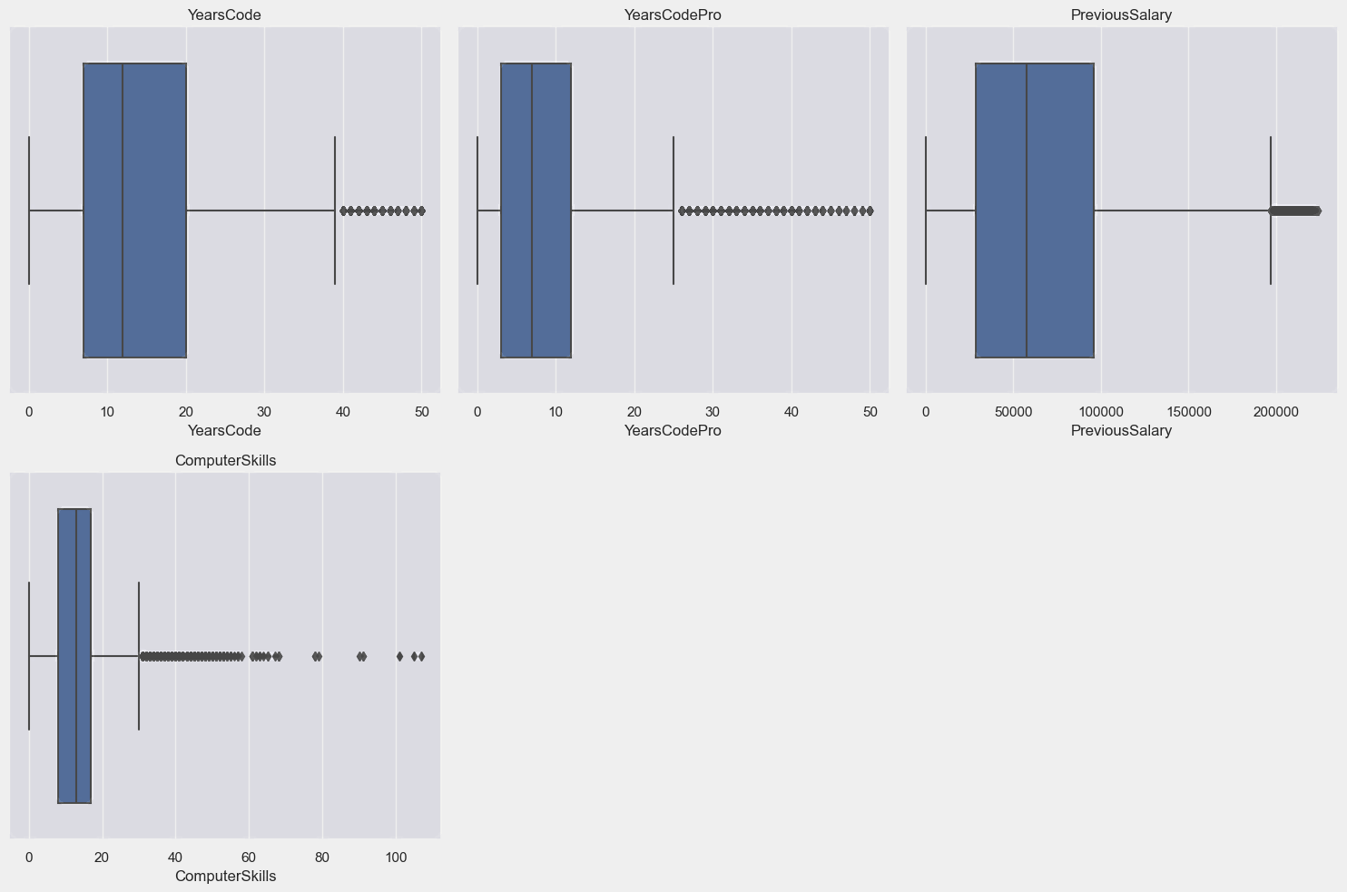

Slide 14
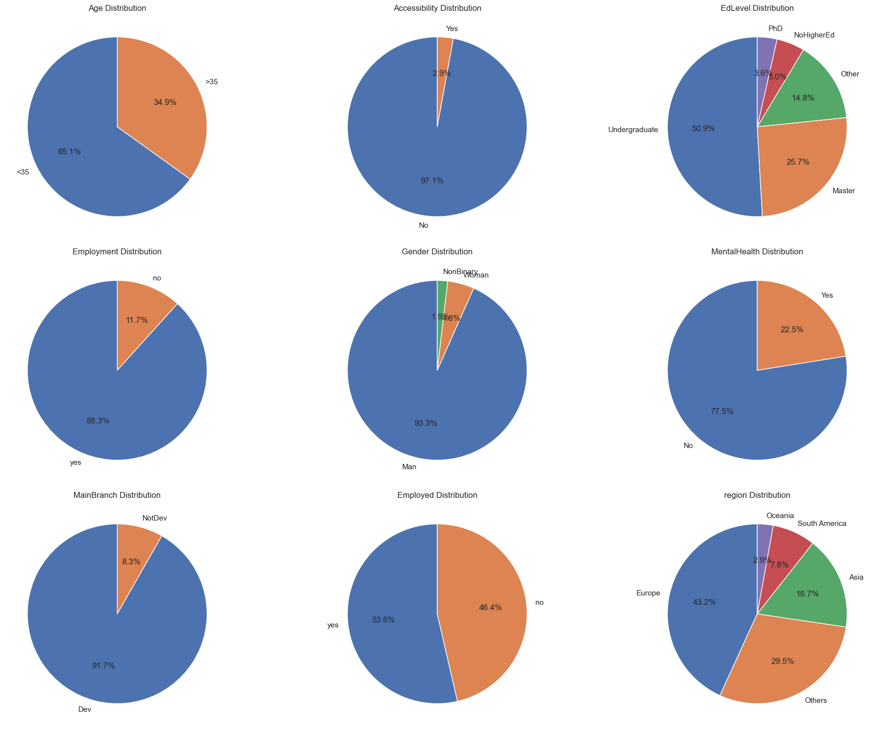

Slide 15
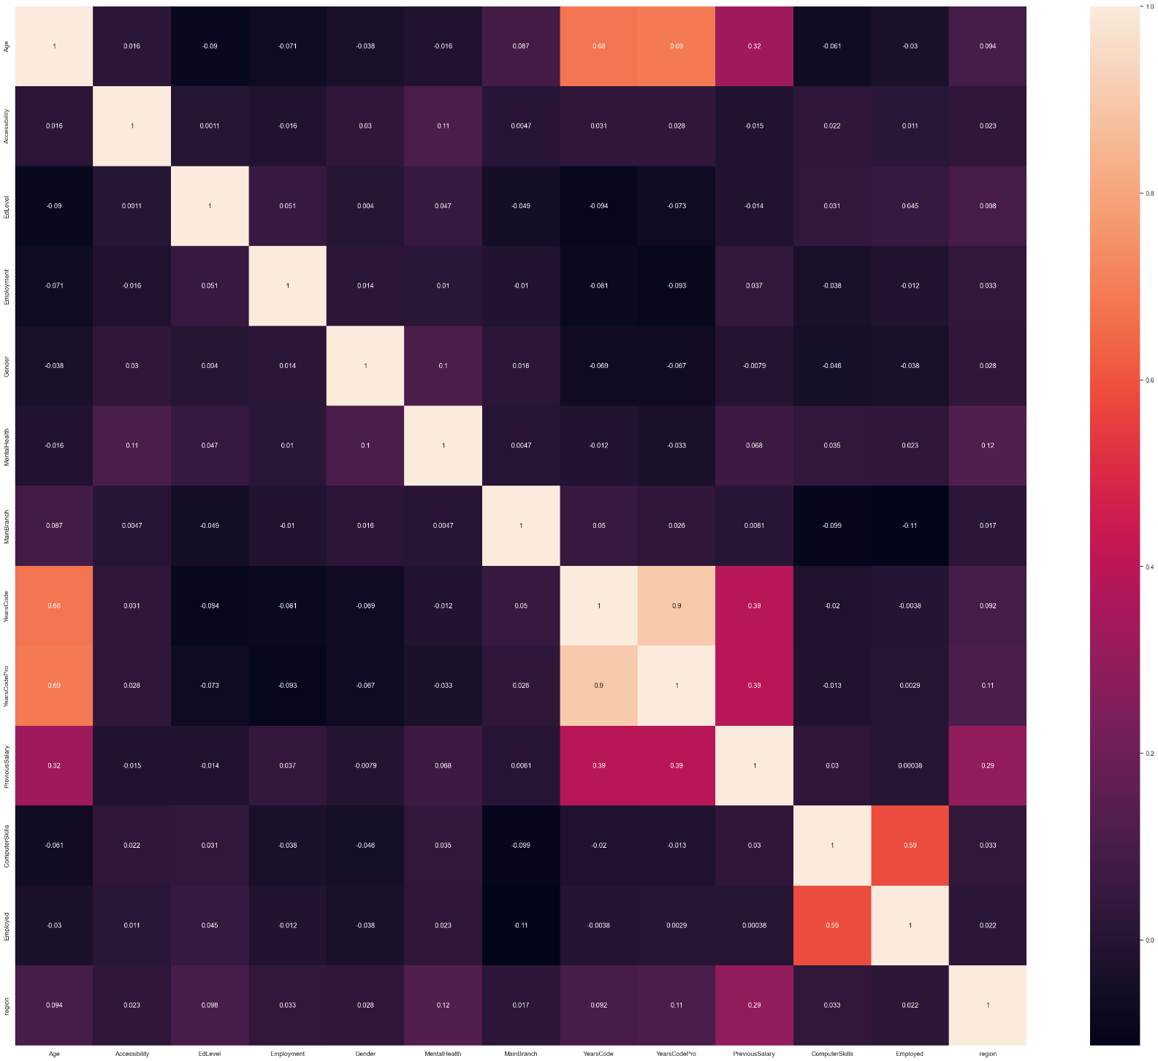
Correlation Heatmap
Jupyter Notebook is a valuable tool for creating correlation heatmaps. A correlation heatmap visualizes the relationships between different variables in the dataset.
Visualization
Feature Selection
Multicollinearity
Model Optimization
By using Jupyter Notebook to create a correlation heatmap, the project gains a powerful tool for understanding the relationships within the dataset and making informed decisions about feature selection and model development in the context of programming job application prediction.

Slide 16

Machine Learning Model Selection
Model selection is the process of choosing the most appropriate machine learning or statistical models for the job application prediction task. This section outlines the various algorithms considered, their strengths and weaknesses, and the rationale behind selecting a specific set of models for experimentation.
Decision Tree Algorithm
ROC Curve
Random Forest Classifier
XGBoost Classifier

Slide 17

Decision Tree Algorithm
Predictive Modeling: Decision trees are used to build models that can predict the outcome of job applications based on various attributes and features.
Tree Structure: Jupyter Notebook helps create and visualize decision trees, which are hierarchical structures that make decisions by recursively splitting the data into subsets based on feature conditions.
Interpretability: Decision trees are easy to interpret, making it accessible for stakeholders to understand the factors influencing job application success.
Feature Importance: Decision trees reveal feature importance, allowing the identification of key attributes that influence the application prediction.
Ensemble Learning: Decision trees can also be used as base models in ensemble techniques like random forests to improve predictive accuracy.
Utilizing the decision tree algorithm within Jupyter Notebook enables the project to develop interpretable models that help understand and predict job application outcomes in the programming industry.

Slide 18
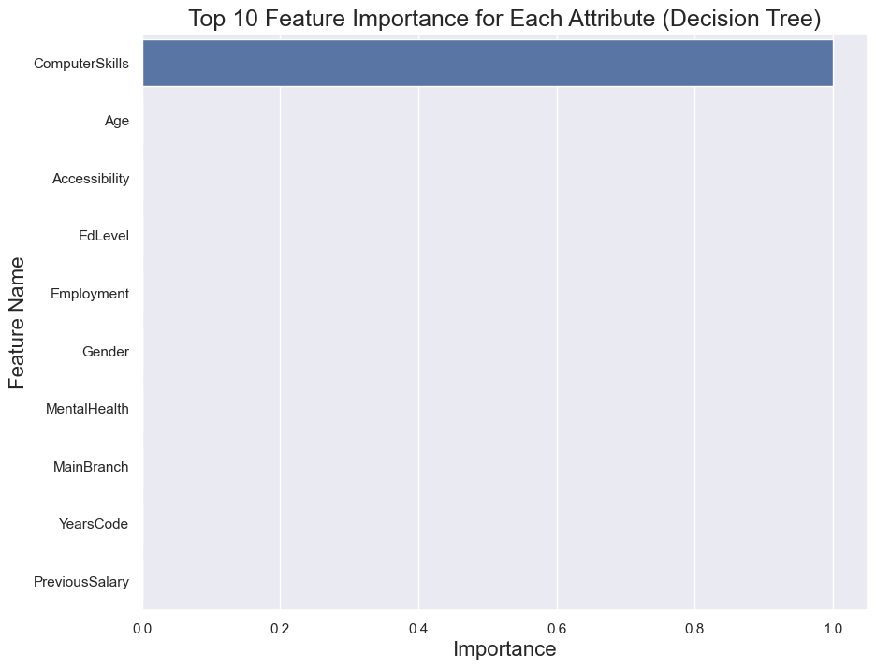

Slide 19
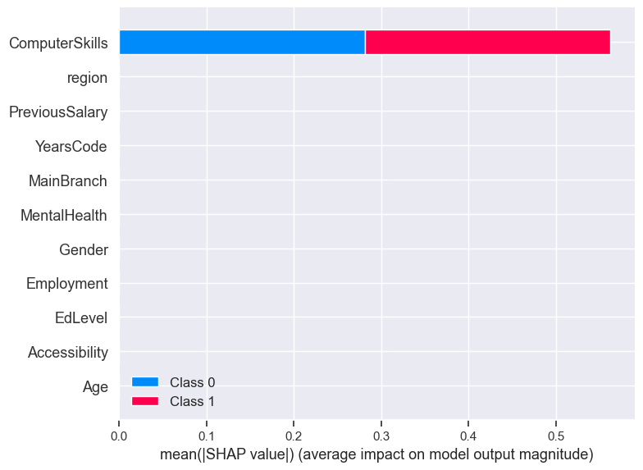

Slide 20
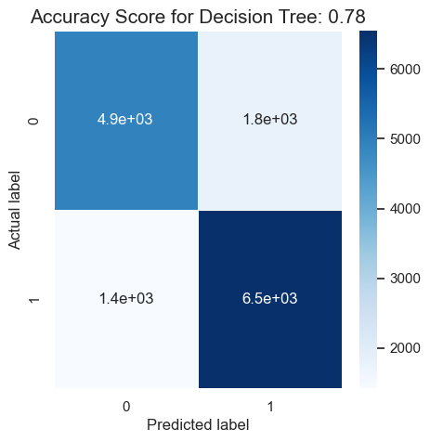

Slide 21
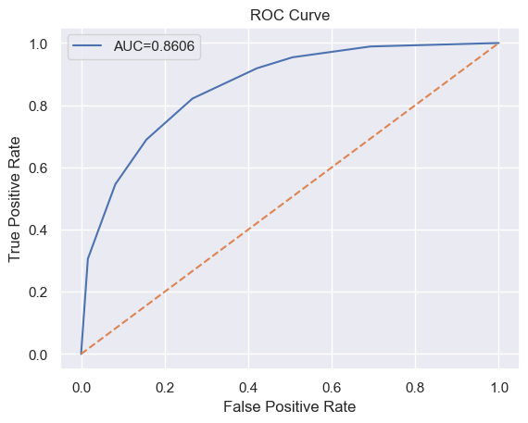
ROC Curve
The ROC (Receiver Operating Characteristic) curve is a valuable tool for evaluating the performance of predictive models.
Model Evaluation: The ROC curve visually represents the trade-off between a model's true positive rate (sensitivity) and its false positive rate as the discrimination threshold varies.
AUC Score: The area under the ROC curve (AUC) provides a single value metric for model performance. A higher AUC indicates better predictive accuracy.
Model Comparison: Jupyter Notebook can be used to create ROC curves for different models, allowing easy comparison to determine which model is most effective at predicting job application success.
Threshold Selection: The ROC curve helps in selecting an appropriate discrimination threshold that balances sensitivity and specificity based on project requirements.
Visual Assessment: The curve's visual representation makes it easy for project stakeholders to understand and assess the model's performance, ensuring that the predictions align with the project's goals.
Using the ROC curve within Jupyter Notebook enhances the project's ability to evaluate and fine-tune predictive models for programming job application outcomes.

Slide 22
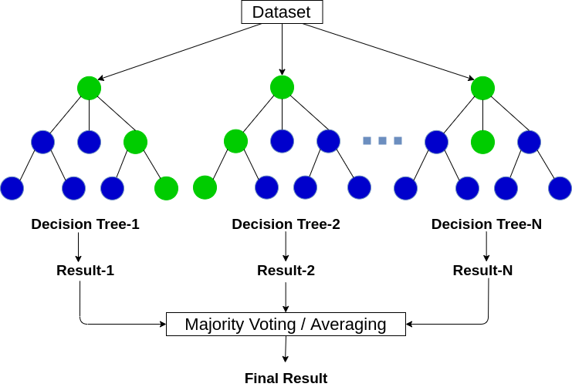
Random Forest Classifier
The Random Forest Classifier is a robust and versatile machine learning algorithm.
Ensemble Technique: Random Forest is an ensemble method that combines multiple decision trees to create a more accurate and robust predictive model.
Model Performance: Jupyter Notebook allows for the creation and evaluation of Random Forest models, which often yield higher predictive accuracy compared to individual decision trees.
Feature Importance: Random Forest can assess the importance of each feature in predicting job application success, aiding in feature selection and understanding key attributes.
Reduced Overfitting: By aggregating the predictions of multiple trees, Random Forest helps reduce overfitting, making it a reliable choice for predictive modeling.
Model Interpretability: While Random Forest is more complex than a single decision tree, Jupyter Notebook can facilitate the interpretation of feature importance and model behavior for project stakeholders.

Slide 23
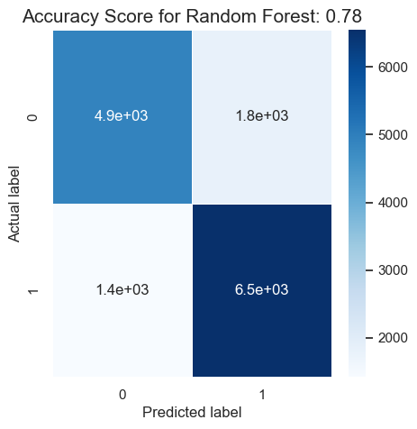

Slide 24

XGBoost Classifier
The XGBoost Classifier is a powerful and popular machine learning algorithm.
Extreme Gradient Boosting: XGBoost is an optimized gradient boosting algorithm that excels in predictive accuracy and model performance.
Model Optimization: Jupyter Notebook can be used to implement and fine-tune XGBoost models, which are known for their capability to handle complex, non-linear relationships in data.
Feature Importance: XGBoost provides insights into feature importance, assisting in the selection of the most influential attributes for predicting job application success.
Regularization: It offers regularization techniques to prevent overfitting, enhancing the model's reliability.
Ensemble Learning: XGBoost can be used as a single powerful model or in ensemble learning, where it can be combined with other models for even better predictive performance.
Leveraging the XGBoost Classifier within Jupyter Notebook elevates the project's predictive modeling capabilities, making it an excellent choice for accurately forecasting programming job application outcomes.

Slide 25
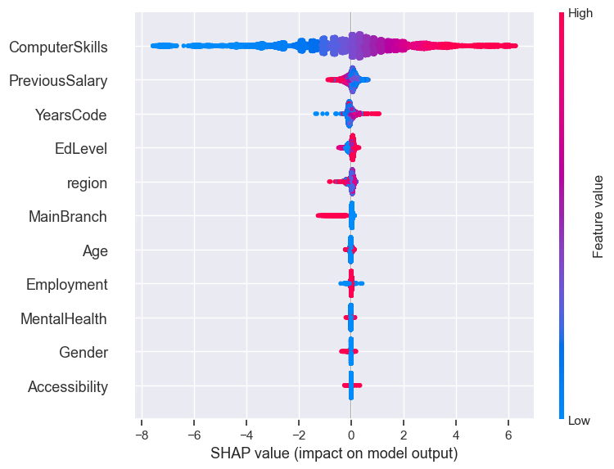

Slide 26
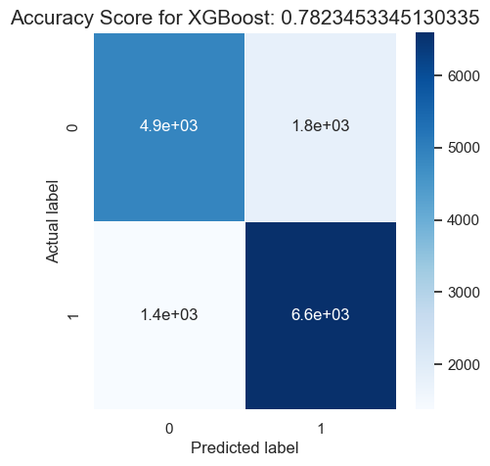

Slide 27
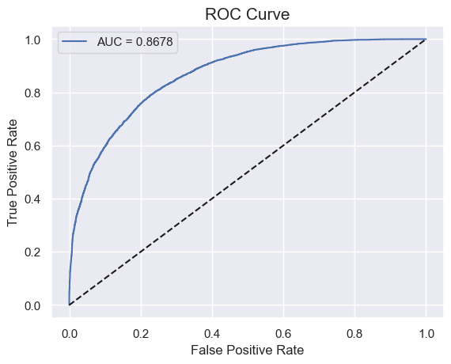

Slide 28
Conclusion
The project on "Programming Job Application Prediction" represents a significant step forward in the realm of data-driven talent acquisition and hiring processes within the programming and tech industry. Through meticulous research, data analysis, and the development of predictive models, this project has provided valuable insights and tools for both job seekers and employrs.
The journey began with a deep dive into the complexities of the tech job market, recognizing the ever-increasing demand for skilled programmers and the challenges faced by organizations in selecting the right candidates. It became evident that traditional hiring methods could benefit immensely from the integration of data-driven predictive models.

Slide 29
Reference
https://www.xoriant.com/blog/decision-trees-for-classification-a-machine-learning-algorithm
https://medium.com/analytics-vidhya/introduction-to-xgboost-algorithm-d2e7fad76b04
https://towardsdatascience.com/understanding-confusion-matrix-a9ad42dcfd62
https://www.turing.com/kb/random-forest-algorithm
https://www.analyticsinsight.net/machine-learning-can-be-your-best-bet-to-transform-your-career/

Slide 30
Thank
You!

